Slide 1
Spark SQL

Slide 2
Spark SQL
Spark SQL is an API for structured data processing.
Contains information about structure of data and computation being performed.
Spark SQL uses internal optimizations. It Internally optimizes the query
using Catalyst optimizer

Slide 3







Spark SQL Architecture
DataFrame (DSL)
Spark SQL and HQL
DataFrame API
DataSource API
External Sources
CSV
JSon
JDBC
Parquet

Slide 4

Spark SQL Architecture
This is the domain-specific language layer where you express your computations through APIs that resemble native data collection operations.
DSL in Spark refers to a specialized set of functions and operators for data manipulation that appear as natural language expressions. It allows users to perform complex data transformations and analysis using a syntax that is more expressive and readable than raw SQL queries or RDD (Resilient Distributed Dataset) manipulations.

Slide 5

Spark SQL Architecture
Spark SQL is the module for working with structured data, while HQL (Hive Query Language) is used for querying data stored in a Hadoop ecosystem using a SQL-like syntax.

Slide 6
Spark SQL Architecture
This is a programming abstraction and a distributed data collection that offers a rich set of operations and optimizations under the hood.

Slide 7
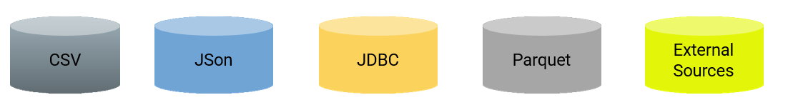
Spark SQL Architecture
An interface that allows Spark SQL to communicate with a variety of data formats and sources like CSV, JSON, and JDBC, enabling data frame creation from different formats.

Slide 8
Spark SQL Use cases
Banking: Credit card fraud detection
Real time analysis of stock market data
Genomic sequencing: Determining the sequence of DNA of an organism
And more

Slide 9

Spark SQL Features
Integrated
Integrated refers to its ability to seamlessly combine SQL queries with the programmatic data manipulations supported by Apache Spark using its Data Frame and Dataset APIs. This integration brings forth several powerful features and benefits:

Slide 10
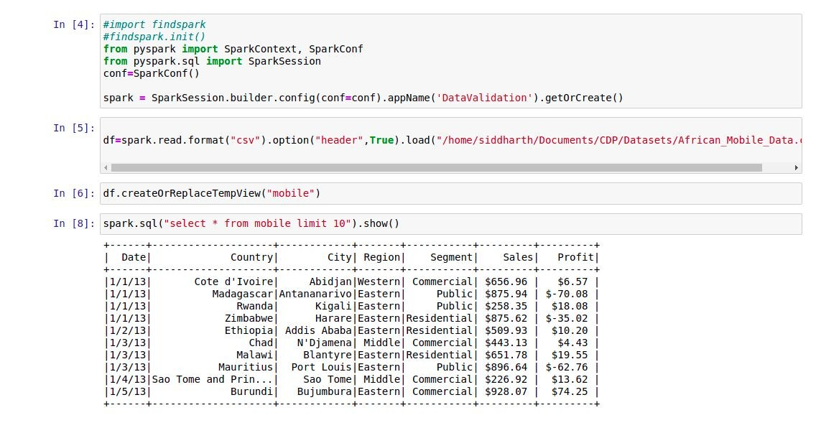

Slide 11
Hive Compatibility: It provides compatibility with Apache Hive, which means it can run Hive queries (using HQL), access Hive UDFs, and even read data stored in Hive without any modification.
Performance and Scalability: Spark SQL offers high performance for large-scale data processing and is designed to be scalable across multiple nodes in a cluster.
Integrated
Standard Connectivity: It supports standard connectivity through JDBC/ODBC, allowing traditional BI and visualization tools to connect with Spark SQL for reporting and analysis.
Unified Data Access: Spark SQL presents a unified interface for data access across diverse data sources, like HDFS, Apache HBase, Apache Cassandra, and relational databases.
Uniﬁed Data Access
Hive Compatibility
Performance and Scalability
Standard Connectivity

Slide 12
Catalyst Optimizer

Slide 13
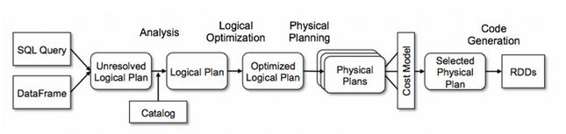
Catalyst Optimizer
Optimiser library within Spark SQL API.
Optimises SQL queries as well as DataFrame code.
Consists of 4 stages: Analysis, Logical Optimization, Physical Planning, Code Generation

Slide 14
Analysis
SQL Query/DataFrame: The process starts with a high-level SQL query or a DataFrame operation provided by the user.
Unresolved Logical Plan: Spark generates an initial logical plan that represents the query; however, this plan has unresolved attributes like names of columns or tables that are not yet linked to the underlying schema.
SQL Query
Unresolved Logical Plan
Logical Plan
DataFrame
Catalog

Slide 15
Logical Optimization
Catalog: The catalog contains metadata about the structure of the data (like databases, tables, columns) and is used to resolve the unresolved attributes in the logical plan.
Logical Plan: After resolution using the catalog, a logical plan with fully resolved attributes is obtained that represents the parsed query.
Analysis
SQL Query
Unresolved Logical Plan
Logical Plan
Optimized Logical Plan
DataFrame
Catalog

Slide 16
Logical Optimization
Analysis
Physical Planning
SQL Query
Unresolved Logical Plan
Optimized Logical Plan
Selected Physical Plan
Logical Plan
DataFrame
Physical Plans
Cost Model
Catalog
Optimized Logical Plan: This logical plan is then transformed through rule-based and cost-based optimizations to produce an optimized logical plan that is more efficient to execute.
Physical Plans: The optimized logical plan is converted into one or more physical plans that dictate how the execution will happen, including the actual physical operations like joins, filters, aggregations, etc.

Slide 17
Logical Optimization
Analysis
Physical Planning
Code Generation
SQL Query
Unresolved Logical Plan
Optimized Logical Plan
Selected Physical Plan
Logical Plan
RDDs
DataFrame
Physical Plans
Cost Model
Catalog
1. Cost Model: The cost model evaluates the physical plans based on factors like data size and computation complexity to estimate the cost of executing each plan.
Selected Physical Plan: The physical plan with the lowest cost according to the cost model is selected for execution.
RDDs: Finally, the selected physical plan is executed as a series of RDD (Resilient Distributed Dataset) transformations and actions across the Spark cluster.

Slide 18
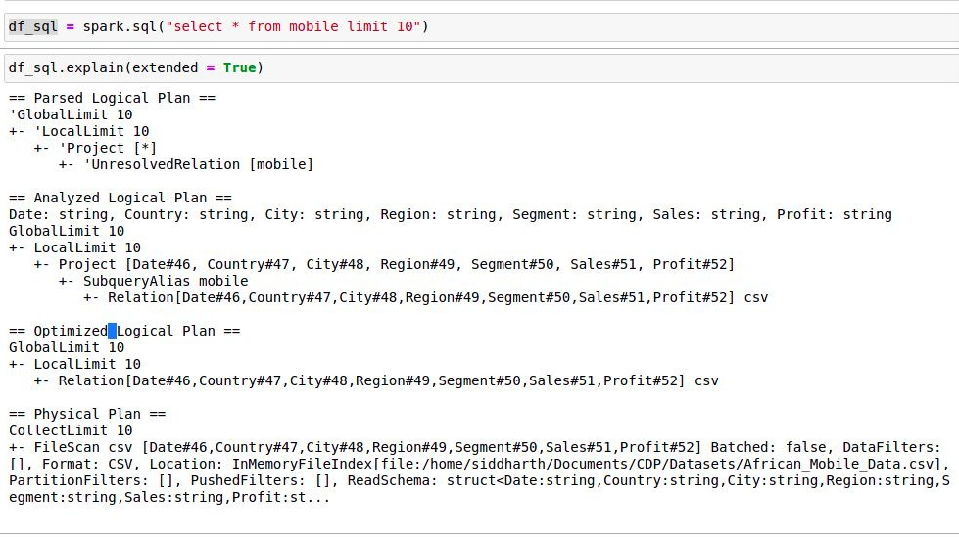

Slide 19
Spark SQL Queries

Slide 20
How to run Spark SQL Queries?
Spark SQL CLI

Slide 21
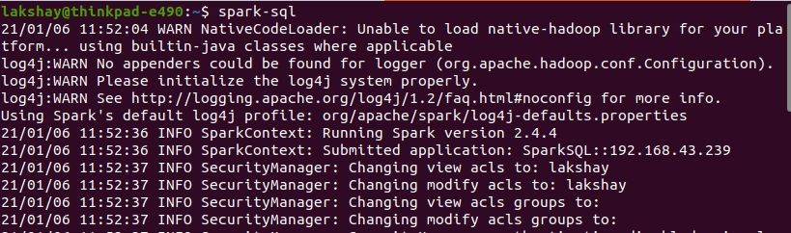
Spark SQL CLI-Command Line Interface

Slide 22
How to run Spark SQL Queries?
Programming SQL Interface
Spark SQL CLI

Slide 23

Programming SQL Interface
SparkSession Object
SQL Query

Slide 24
Why do we need Spark SQL?

Slide 25







Why do we need Spark SQL?
Spark SQL was built to overcome the limitations of Apache Hive running on top of Apache Spark
To provide a easy programming interface for non programmers

Slide 26
Limitations of Hive
Hive uses Mapreduce which lags in performance with medium and small sized datasets
Hive cannot drop encrypted databases

Slide 27
Spark SQL advantages over Hive
Faster execution
60 hours
10 hours

Slide 28
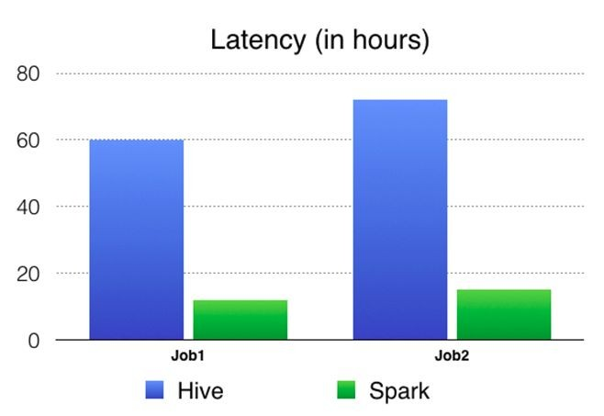
Apache Spark: A 60 TB+
60 TB data handled with Hive and Spark
production use case

Slide 29



Spark SQL advantages over Hive
Faster execution
60 hours
No migration hurdles
Real time querying
10 hours
Spark SQL uses metastore service of Hive to query the data stored and managed by Hive.

Slide 30
Thank You!!

